Slide 1




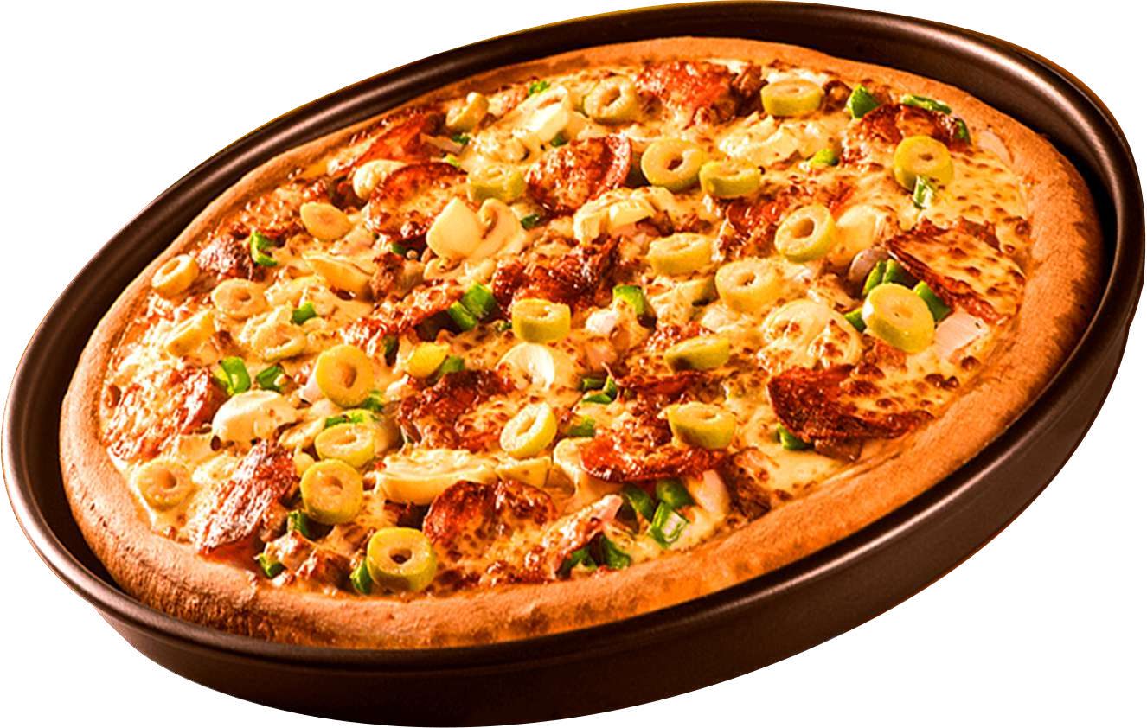

PIZZA SALES ANALYSIS USING SQL
By Rati Yadav

Slide 2



HELLO
My name is Rati Yadav. In this project I have utilized SQL queries to solve the question those are related to the pizza sales.

Slide 3



OBJECTIVE
This project is all about pizza sales numbers to find out how well the restaurant is doing and what trends there are. I want to use this information to make smarter decisions and plan better for the future.

Slide 4



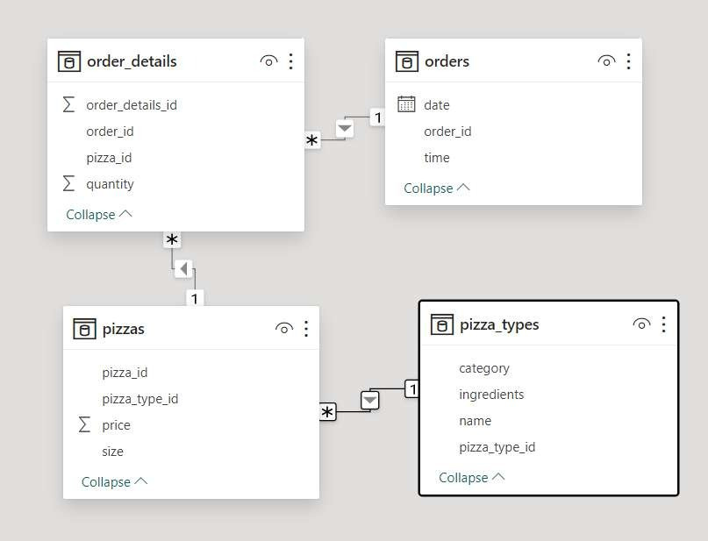


DATA MODEL VIEW

Slide 5
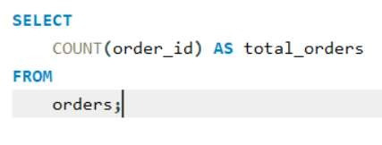
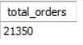


1. RETRIEVE THE TOTAL NUMBER OF ORDERS PLACED

Slide 6
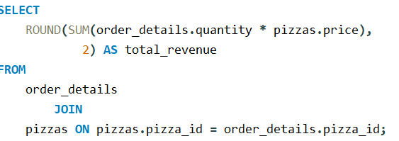
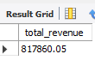
2. CALCULATE THE TOTAL REVENUE GENERATED FROM PIZZA SALES.

Slide 7
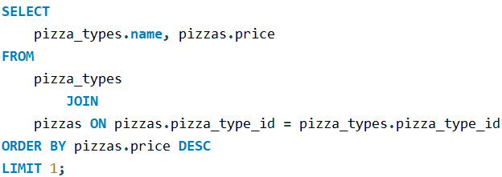
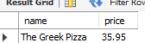
3. IDENTIFY THE HIGHEST-PRICED PIZZA.

Slide 8
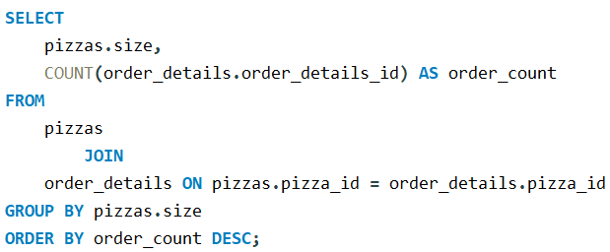
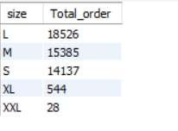
4. IDENTIFY THE MOST COMMON PIZZA SIZE ORDERED.

Slide 9
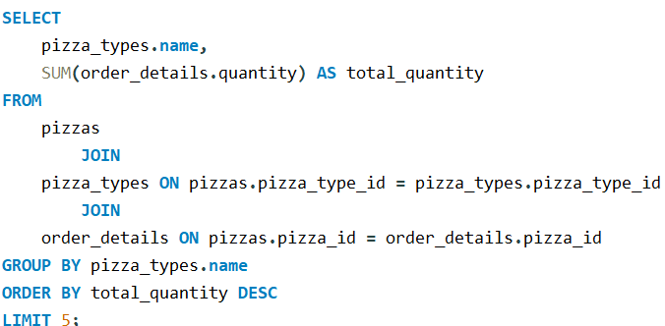
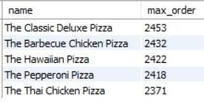
5.LIST THE TOP 5 MOST ORDERED PIZZA TYPES ALONG WITH THEIR QUANTITIES

Slide 10
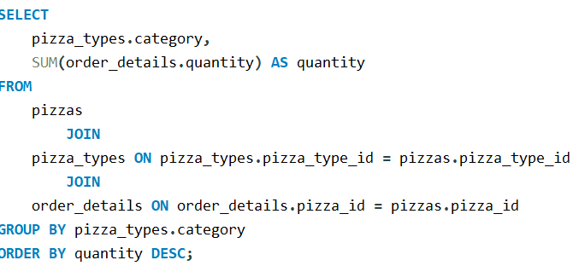
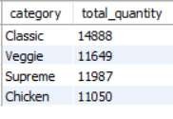
6.JOIN THE NECESSARY TABLES TO FIND THE TOTAL QUANTITY OF EACH PIZZA CATEGORY ORDERED

Slide 11
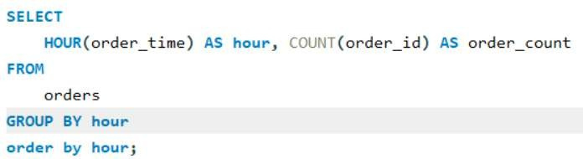
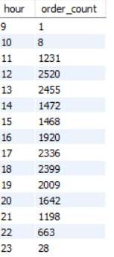
7.DETERMINE THE DISTRIBUTION OF ORDERS BY HOUR OF THE DAY.

Slide 12
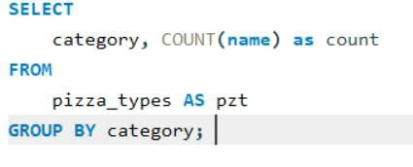
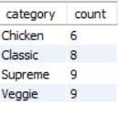
8.JOIN RELEVANT TABLES TO FIND THE CATEGORY-WISE DISTRIBUTION OF PIZZAS

Slide 13
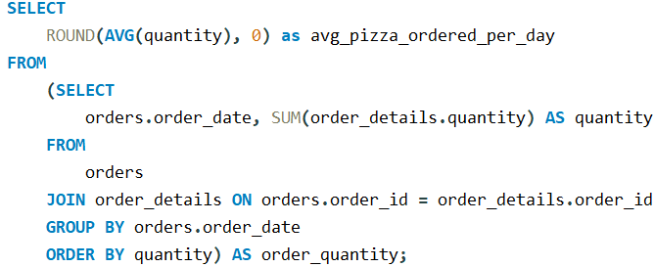
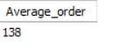
9.GROUP THE ORDERS BY DATE AND CALCULATE THE AVERAGE NUMBER OF PIZZAS ORDERED PER DAY..

Slide 14
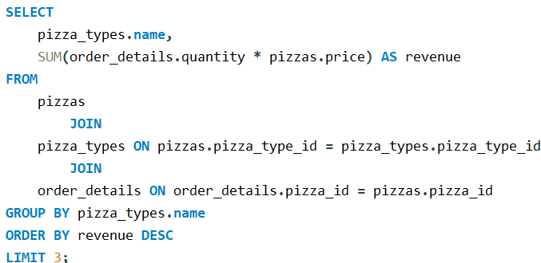
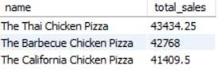
10.DETERMINE THE TOP 3 MOST ORDERED PIZZA TYPES BASED ON REVENUE..

Slide 15
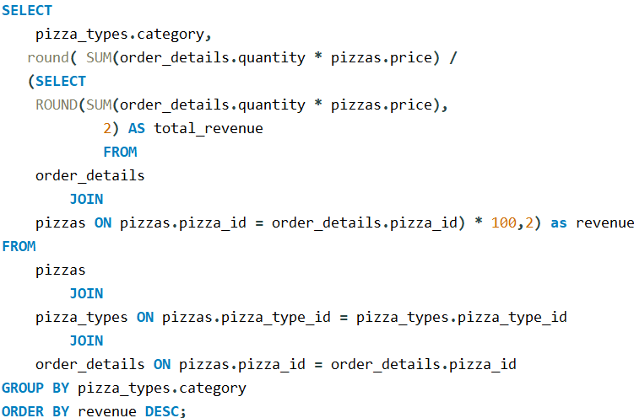
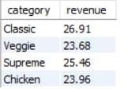
11.CALCULATE THE PERCENTAGE CONTRIBUTION OF EACH PIZZA TYPE TO TOTAL REVENUE.

Slide 16
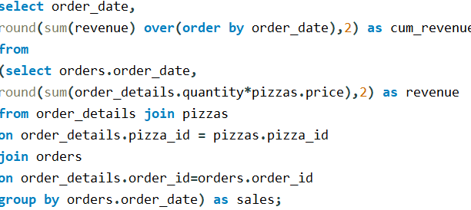
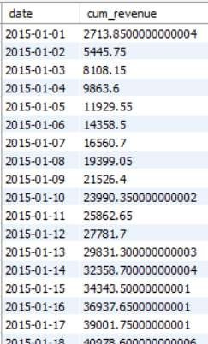
12. ANALYZE THE CUMULATIVE REVENUE GENERATED OVER TIME.

Slide 17
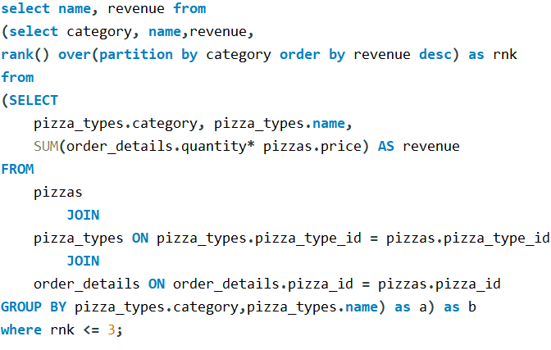
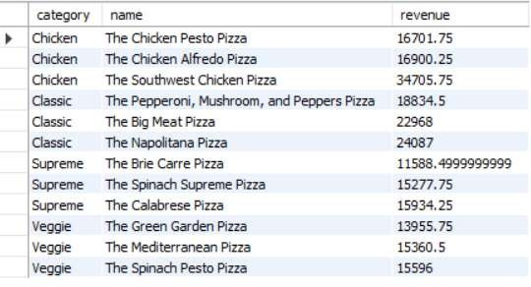
13) Determine the top 3 most ordered pizza types based on revenue for each pizza category

Slide 18

THANK YOU

